Slide 1
Energy Consumption Analysis
Sub-meters’ Usage and Insights

Slide 2
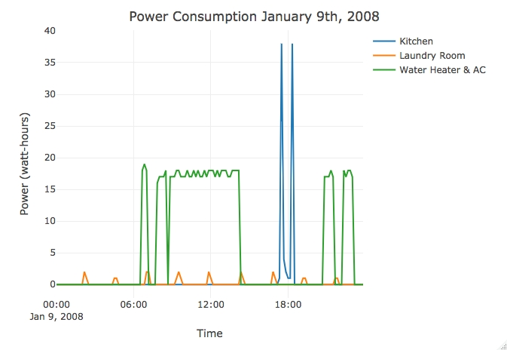
Sub-meter Visualizations
Power consumption of all three sub-meters on Jan 9th, 2008.

Slide 3
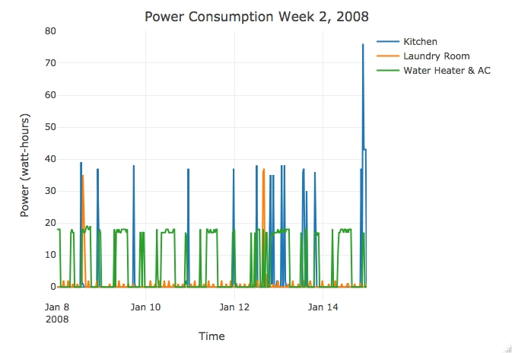
Sub-meter Visualizations
Power consumption for a second week in January, 2008.

Slide 4
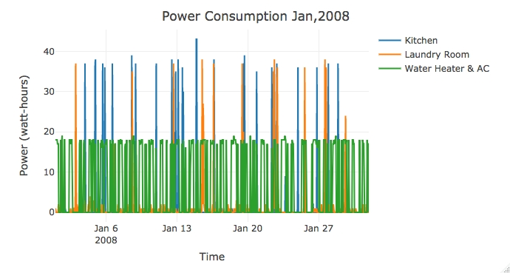
Sub-meter Visualizations
Power Consumption for a month in January, 2008.

Slide 5
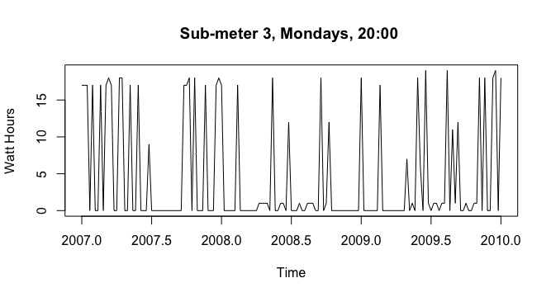
Time Series Visualizations
Graph shows Sub-meter 3(Water Heater & AC) at 20:00 on Mondays from 2007 to 2009.

Slide 6
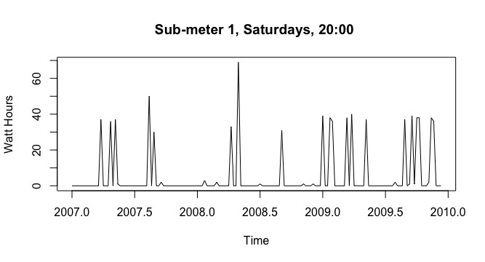
Time Series Visualizations
Graph shows Sub-meter 1(Kitchen) at 20:00 on Mondays from 2007 to 2009.

Slide 7
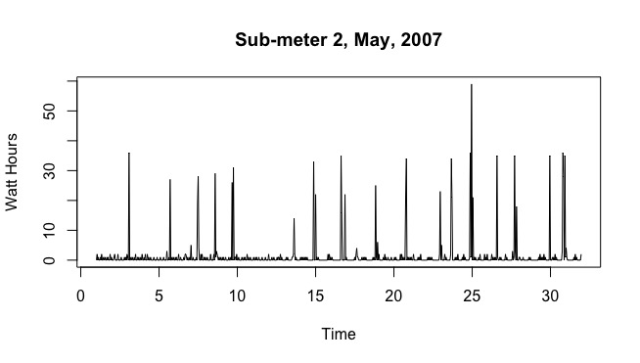
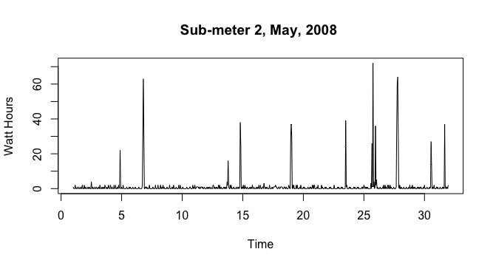
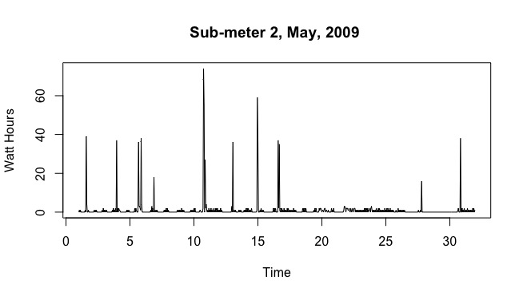
Comparison of Sub-meter 2(Laundry Room) power consumption in May, for 2007, 2008 and 2009.
Power consumption of May in 2008 and first half of May in 2009 is considerably less than the consumption of May in 2007.
More insights could be drawn for each individual month.

Slide 8
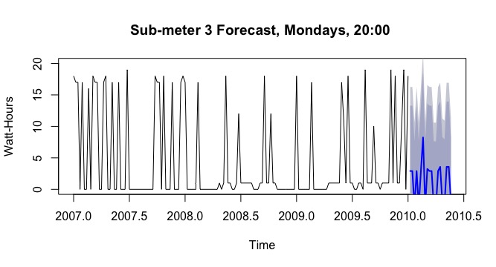
Forecast Visualizations
Forecast of Sub-meter 3 for the first 20 weeks at 20:00 of 2010.

Slide 9
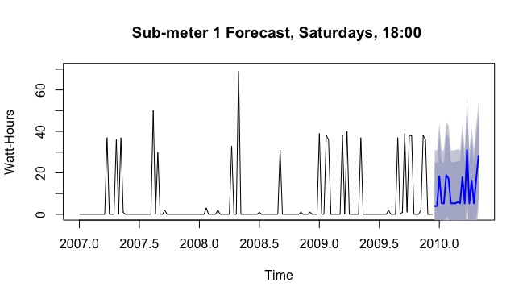
Forecast of Sub-meter 1 for the first 20 weeks at 18:00 of 2010.

Slide 10
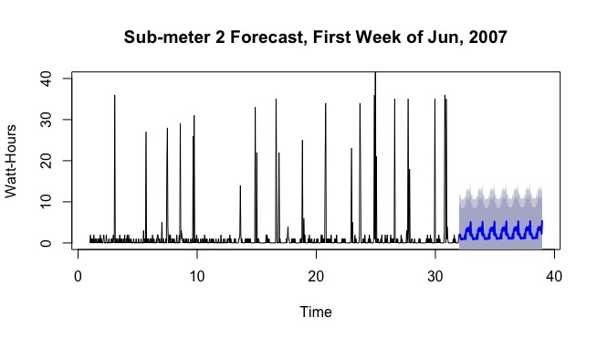
Forecast of Sub-meter 2(Laundry) for the first week of June, 2007.

Slide 11
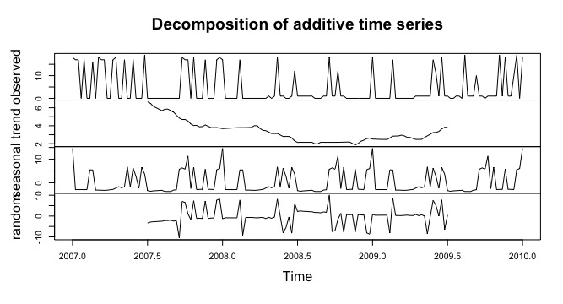
Decomposition Visualizations
Decomposition of Sub-meter 3(Water Heater & AC) at 20:00 on Mondays from 2007 to 2009.
Trend component shows the power consumption was the lowest during 2009, it started to go up again since 2009.

Slide 12
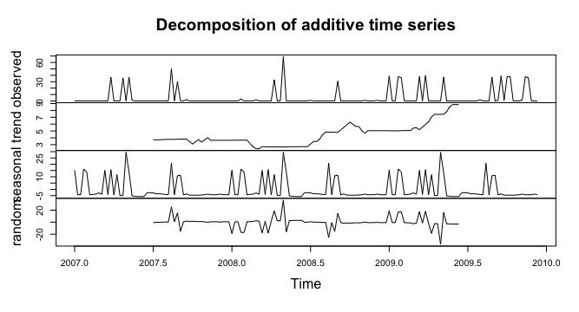
Decomposition of Sub-meter 1(Kitchen) at 20:00 on Mondays from 2007 to 2009.
Trend component shows the power consumption went up since the second half of 2008.

Slide 13
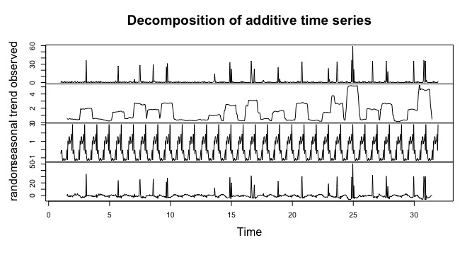
Decomposition of Sub-meter 2(Laundry Room) power consumption in May, 2007.
Decomposition shows a clear daily seasonality.

Slide 14
Statistic Summary Comparison
WH & AC
Kitchen
Laundry
 | Min | 1st Qu | Median | Mean | 3rd Qu | Max
Seasonal | -3.96 | -3.05 | -2.69 | -0.09 | 5.49 | 14.71
Trend | 1.77 | 2.36 | 3.02 | 3.25 | 3.76 | 6.50
Random | -10.55 | -1.72 | -0.12 | -0.23 | 1.26 | 10.10
 | Min | 1st Qu | Median | Mean | 3rd Qu | Max
Seasonal | -5.71 | -4.43 | -4.06 | 0.06 | -2.69 | 29.52
Trend | 2.40 | 3.46 | 3.79 | 4.44 | 5.05 | 8.87
Random | -36.94 | -1.28 | -0.07 | -0.07 | 1.15 | 36.81
 | Min | 1st Qu | Median | Mean | 3rd Qu | Max
Seasonal | -1.34 | -1.21 | -0.12 | 0.00 | 1.01 | 3.03
Trend | 0.13 | 0.40 | 1.42 | 1.54 | 2.48 | 5.21
Random | -6.70 | -2.05 | -0.72 | -0.00 | 0.37 | 50.85

Slide 15
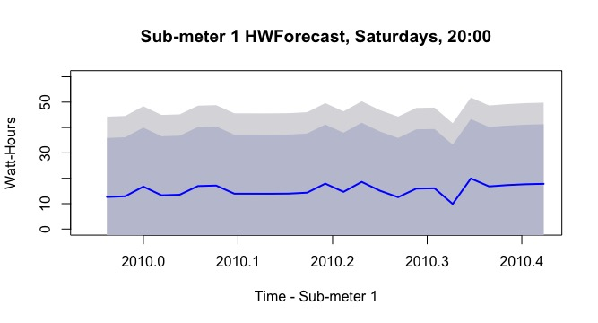
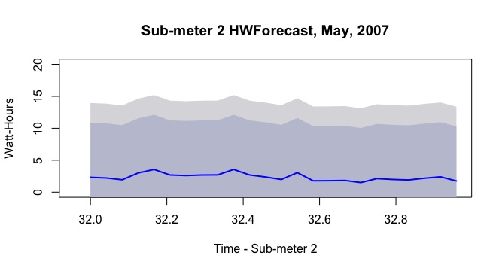
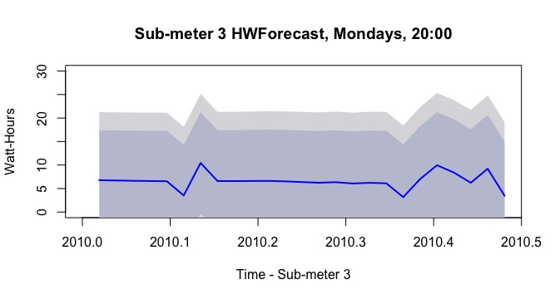
More Forecasting (Holts-Winter)
Sub-meter 1(Kitchen) forecasting for the first 25 weeks on Saturdays at 18:00 for 2010.
Sub-meter2(Laundry) forecasting for the first week for June, 2007.
Sub-meter 3(Water Heater & AC) forecasting for the first 25 weeks on Mondays at 20:00 for 2010.

Slide 16
Data Insights
AC power consumption appears to peak around noon.
Suggest to turn the temperature higher when leaving home.
There is a trend going down in 2008 for the Water Heater & AC consumption.
Suggest to investigate the reasons and maybe that’ll indicate the possibility to save power in the future.
Power consumption in the kitchen varies, probably due to dishwasher usage.
Data Suggestions
Add outdoor temperature to the dataset, so that we can get insights regarding the outdoor temperature changes.

Slide 17
Achieved Project Goals
Empower Smart Home owners with greater understanding and control of their power usage.
A big step to the developer’s goal of offering highly efficient Smart Homes that providing owners with power usage analytics.
Accurate energy monitoring for utility company

Slide 18
Business Recommendation
Separate Water Heater and AC to two different sub-meters, so it’ll be more explicit for either homeowner or the utility company to understand the two most power consuming appliances.
Generate the consumption comparison of the current month and the previous month to help homeowner understand what behaviors could lead to less power usage.
Develop a reminder system to remind homeowner when the power consumption reaches certain amount.
Develop an app that homeowner can monitor the power consumption when they want to. For example, how much more power it’ll use if patio door is left open when the AC is on?
Generate how much power it has saved by using sub-meters for the utility company.

Slide 19
Thank You!

